Slide 1
Lab Equipment

Slide 2
Beaker – 400 mL

Slide 3
Graduated Cylinder

Slide 4
Erlenmeyer Flask

Slide 5
Bunsen Burner

Slide 6
Wire Gauze

Slide 7
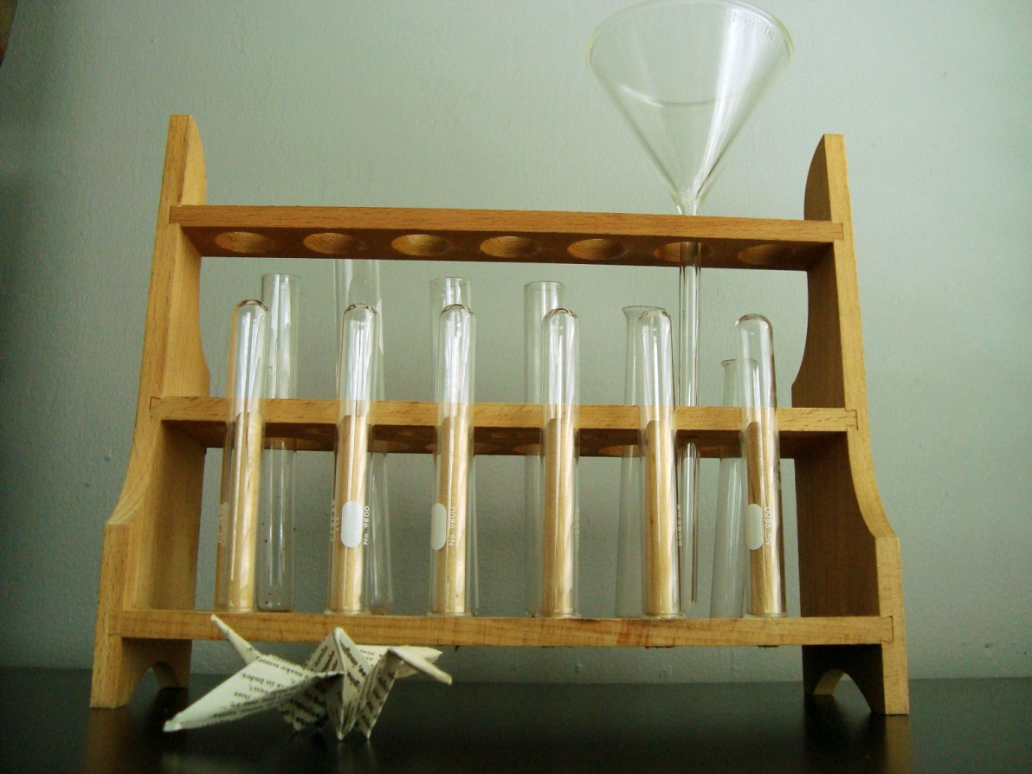
Test Tubes & Test Tube Rack

Slide 8
Scoopula

Slide 9
Crucible Tongs

Slide 10
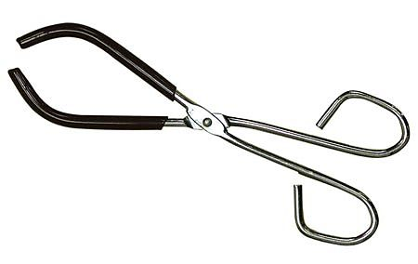
Beaker Tongs

Slide 11
Test Tube Holder

Slide 12
Test Tube Clamp

Slide 13
Clay Triangle

Slide 14
Funnel

Slide 15
Forceps

Slide 16
Glass Stirring Rod

Slide 17
Iron Ring

Slide 18
Ring Stand

